Slide 1

INT301
Open Source Technologies
Lecture 0

Slide 2
Course details
LTP – 0 0 4
Books
Your Unix: The Ultimate Guide By Sumitabha Das, Mcgraw Hill Education
Fundamentals Of Open-Source Software by M. N. RAO, PHI Learning Pvt Ltd
Guide to Computer Forensics and Investigations by CHRISTOPHER STEUART, BILL NELSON, AMELIA PHILLIPS, Cengage learning

Slide 3
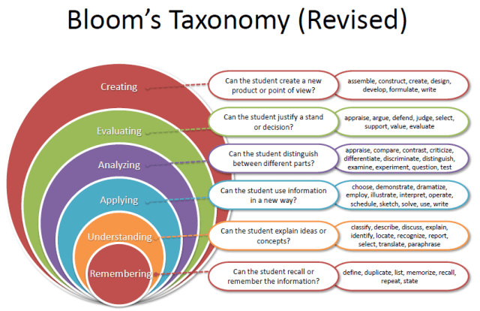
Revised Bloom’s Taxonomy

Slide 4
Program Outcomes
PO1 Engineering Knowledge:: Apply the knowledge of mathematics, science, engineering fundamentals, and an engineering specialization to the solution of complex engineering problems.
PO2 Problem Analysis:: Identify, formulate, research literature, and analyze complex engineering problems reaching substantiated conclusions using first principles of mathematics, natural sciences, and engineering sciences.
PO3 Design/development of solutions:: Design solutions for complex engineering problems and design system components or processes that meet the specified needs with appropriate consideration for the public health and safety, and the cultural, societal, and environmental considerations.
PO4 Conduct investigations of complex problems:: Use research-based knowledge and research methods including design of experiments, analysis and interpretation of data, and synthesis of the information to provide valid conclusions.

Slide 5
Program Outcomes
PO5 Modern tool usage:: Create, select, and apply appropriate techniques, resources, and modern engineering and IT tools including prediction and modeling to complex engineering activities with an understanding of the limitations.
PO6 The engineer and society:: Apply reasoning informed by the contextual knowledge to assess societal, health, safety, legal and cultural issues and the consequent responsibilities relevant to the professional engineering practice.
PO7 Environment and sustainability:: Understand the impact of the professional engineering solutions in societal and environmental contexts, and demonstrate the knowledge of, and need for sustainable development.
PO8 Ethics:: Apply ethical principles and commit to professional ethics and responsibilities and norms of the engineering practice.
PO9 Individual and team work:: Function effectively as an individual, and as a member or leader in diverse teams, and in multidisciplinary settings.

Slide 6
Program Outcomes
PO10 Communication:: Communicate effectively on complex engineering activities with the engineering community and with society at large, such as, being able to comprehend and write effective reports and design documentation, make effective presentations, and give and receive clear instructions.
PO11 Project management and finance:: Demonstrate knowledge and understanding of the engineering, management principles and apply the same to one’s own work, as a member or a leader in a team, manage projects efficiently in respective disciplines and multidisciplinary environments after consideration of economic and financial factors.
PO12 Life-long learning:: Recognize the need for, and have the preparation and ability to engage in independent and life-long learning in the broadest context of technological change.
PO13 Competitive Skills:: Ability to compete in national and international technical events and building the competitive spirit along with having a good digital footprint.

Slide 7
CO Mapping
Quality Education
This course is globally recognized
Gender Equality
Offering this course to equip individuals with knowledge, irrespective of their gender
Industry Innovation and Infrastructure
This course fulfills the industry needs

Slide 8
Course Outcomes
Through this course students should be able to:
CO1: Recall Open-Source Software Development Methods to understand open-source models, licenses, copyrights, and Intellectual property
CO2: Apply shell script concepts to automate commands and repetitive tasks
CO3: Apply concepts to build shell functions, handle scripts with signals, manage version control, and debug multiple files.
CO4:: discuss the importance and use of Git and Git-hub in the project development
CO5:: Apply various open-source tools in Digital Forensics
CO6:: Use FTK imager to create, and analyze a forensic image, capture memory, encrypt and export files

Slide 9
The course contents
Unit 1
Open Source Software Development Methods: Introduction to Open Source Software Development Methods, Open Source Software, Proprietary Software, Pragmatism vs Idealism, History of Open Source Software, Advantages of OSS, OSS Licenses types, Copyrights: Fundamental of copyright, filing copyright, copyleft, Introduction to Intellectual property, types of intellectual property, Intellectual property Registration steps
Unit 2
Open Source for Developers: Fundamentals of Bash Shell Scripting: Creating and executing scripts, working with variables and input, command line arguments, control structures: if, nested if, test, case, while, for.

Slide 10
The course contents
Unit 3
Advanced Bash Shell Scripting: Shell script Functions, Script control- handling the signals
Version Control: using RCV and CVS, debugging using gdb, handling multiple source files using make, creation of manual pages
Unit 4
Open Source Revision Control Systems: Git and GitHub Introduction, Installing Git , Getting started on GitHub, Configuring Git, Creating a Git repository, Creating and editing files, Adding files to your Git repository, Making changes and tracking them, Synchronizing your local Git repository with GitHub, Deleting and renaming files, Undoing changes, Branching, Tags and releases, Downloading a repository, Managing multiple copies of a repository

Slide 11
The course contents
Unit 5
Widely used open-source tools in Digital Forensics: Computer forensics fundamentals, Benefits of forensics, computer crimes, computer forensics, Digital evidence, Types of digital evidence: Volatile data, Nonvolatile data, Digital forensics tools: File analysis tools, Network analysis tools, Database analyzers, Registry tools, Data capture tools, Email scanners
Unit 6
Open-source FKT Tools: Creating a Forensic Image, Capturing Memory, Analyzing Image dump, Mounting Images to Drive, Custom Content Images using AD encryption, Decrypt AD Encryption, Obtain Protected Files, Detect EFS Encryption, Export Files, disk imaging using ftk imager

Slide 12
Course Assessment Model
Marks break up
Attendance 5%
CAP 45%
ETP 50%
Total 100%
Three Class test – One before MTE and Two after MTE (3rd Compulsory)

Slide 13
Course Assessment Model
Nature of CA
CA1: Theory Test
CA2: Apply for IPR/Copyright
CA3: Group Project (Compulsory)

Slide 14
Practical Applications
Students will be
Aware of IPR/Copyright process
Able to create and control the project along with its versions
Able to understand various tools in Digital Forensics

